Slide 1
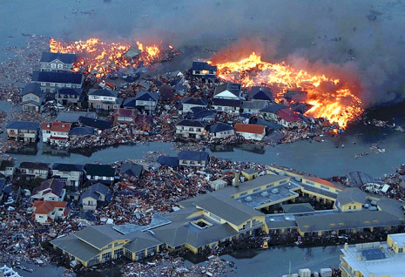
Disaster
Sendai Earthquake

Slide 2
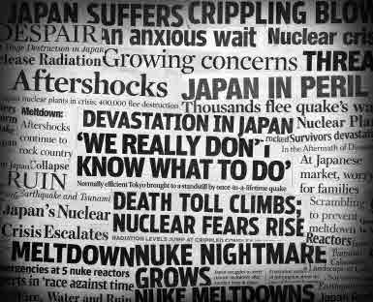
Disaster
Copyright ©2011 iStockphoto LP
Sendai Earthquake

Slide 3
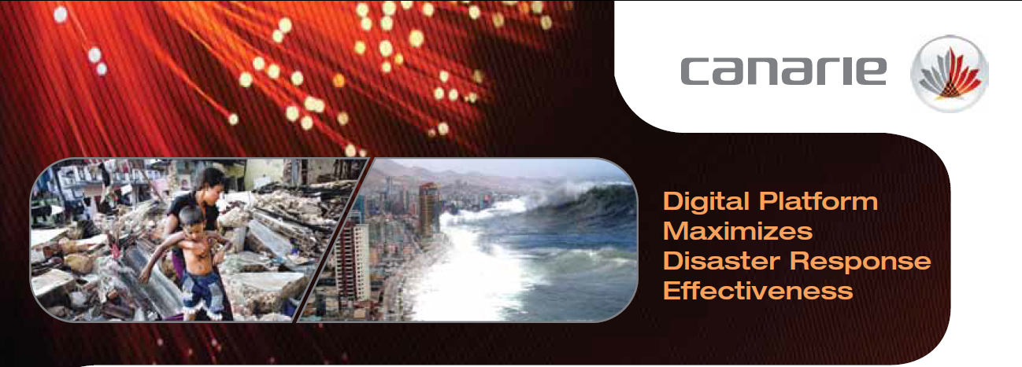





Prioritizing Resources
Helps Save Lives
Disaster Response
Network-Enabled Platform DR-NEP

Slide 4
Value to Research and to Canada:
Real-time network-enabled disaster management
Virtual community of Canadian and international emergency responders
Best practice formulation through "what-if" scenario analyses
Disaster Response Network-Enabled Platform DR-NEP

Slide 5



Current Disaster Management
Recovery
Risk mitigation
Response
Preparedness
Local experience. Local knowledge. Local groups.

Slide 6
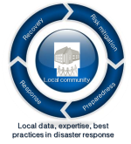
Current Disaster Management
Local experience. Local knowledge. Local groups.

Slide 7
Current Disaster Management
How to connect local expertise into a real-time virtual community?

Slide 8
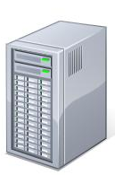

Network-Enabled
Disaster Management
Best Practices.
Powerful Simulation Tools.
Knowledge Network.
Disaster Respone Network-Enabled Platform DR-NEP

Slide 9
Disaster
Copyright ©2011 iStockphoto LP
Sendai Earthquake

Slide 10
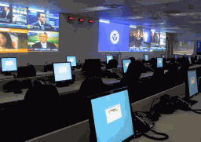
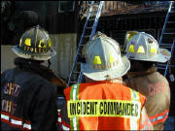
Community Disaster Management &
Emergency Operations Centre
Local
EOC
Current Decision-Making Approach
Local experience. Local knowledge. Local groups.
©courtesy of Emergency Management Ontario
Sendai Earthquake

Slide 11
Community Disaster Management &
Emergency Operations Centre
Local
EOC
How to connect local expertise into a real-time virtual community?
©courtesy of Emergency Management Ontario
Sendai Earthquake

Slide 12
Emergency Operations Centre
(Network-Enabled EOC)
Local
EOC
DR-NEP
Interdependencies Simulator
Infrastructure Simulators
Sensor Networks
Decision Support Systems
©courtesy of Emergency Management Ontario
Sendai Earthquake
Disaster Response Network-Enabled Platform DR-NEP

Slide 13
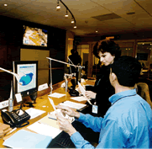
Emergency Operations Centre
(Network-Enabled EOC)
Local
EOC
XOC
“What-if” scenarios
DR-NEP
Interdependencies Simulator
Infrastructure Simulators
Sensor Networks
Decision Support Systems
Simulated outputs
©courtesy of Emergency Management Ontario
Sendai Earthquake
Disaster Response Network-Enabled Platform DR-NEP

Slide 14
Emergency Operations Centre
(Network-Enabled EOC)
Local
EOC
XOC
“What-if” scenarios
DR-NEP
Interdependencies simulator
Infrastructure Simulators
Sensor Networks
Decision Support Systems
Scenarios
evaluation
Simulated outputs
©courtesy of Emergency Management Ontario
More effective directions and resource allocation
Sendai Earthquake
Disaster Response Network-Enabled Platform DR-NEP

Slide 15
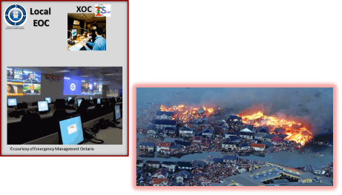
Network-Enabled Disaster Management
Real-time access to best practices, powerful simulation tools, and experts all over the world.
Disaster Response Network-Enabled Platform DR-NEP

Slide 16
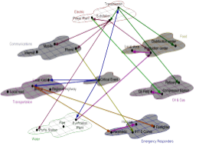
DR-NEP Workflow
Risk Mitigation & Preparedness
Continuous Knowledge Improvement
Local
EOC
PREPAREDNESS
EXERCISES
LOCAL /
REMOTE
XOC
INTERDEPENDENCY
CONSULTANTS
INFRASTRUCTURE , UTILITIES, SENSORS
CONSULTANTS
DR-NEP
DEVELOPMENT
CONSORTIUM

Slide 17
DR-NEP Workflow
Risk Mitigation & Preparedness
Continuous Knowledge Improvement
Local
EOC
PREPAREDNESS
EXERCISES
LOCAL /
REMOTE
XOC
INTERDEPENDENCY
CONSULTANTS
INTERDEPENDENCY MODELS
INFRASTRUCTURE , UTILITIES, SENSORS
CONSULTANTS
INFRASTRUCTURE MODELS
DR-NEP
DEVELOPMENT
CONSORTIUM
DR-NEP SOFTWARE ARCHITECTURE

Slide 18
DR-NEP Workflow
Risk Mitigation & Preparedness
Continuous Knowledge Improvement
Local
EOC
PREPAREDNESS
EXERCISES
LOCAL /
REMOTE
XOC
INTERDEPENDENCIES & DECISION-MAKING
SIMULATIONS
INTERDEPENDENCY
CONSULTANTS
INTERDEPENDENCY MODELS
INFRASTRUCTURE , UTILITIES, SENSORS
CONSULTANTS
INFRASTRUCTURE MODELS
DR-NEP
DEVELOPMENT
CONSORTIUM
DR-NEP SOFTWARE ARCHITECTURE

Slide 19
DR-NEP Workflow
Risk Mitigation & Preparedness
Continuous Knowledge Improvement
Local
EOC
PREPAREDNESS
EXERCISES
SIMULATION & EXERCISE ASSESSMENTS
LOCAL /
REMOTE
XOC
INTERDEPENDENCIES & DECISION-MAKING
SIMULATIONS
INTERDEPENDENCY
CONSULTANTS
INTERDEPENDENCY MODELS
INFRASTRUCTURE , UTILITIES, SENSORS
CONSULTANTS
INFRASTRUCTURE MODELS
DR-NEP
DEVELOPMENT
CONSORTIUM
DR-NEP SOFTWARE ARCHITECTURE

Slide 20
DR-NEP Workflow
Risk Mitigation & Preparedness
Continuous Knowledge Improvement
Local
EOC
PREPAREDNESS
EXERCISES
SIMULATION & EXERCISE ASSESSMENTS
LOCAL /
REMOTE
XOC
INTERDEPENDENCIES & DECISION-MAKING
SIMULATIONS
DR-NEP KNOWLEDGE DATABASE
INTERDEPENDENCY
CONSULTANTS
INTERDEPENDENCY MODELS
INFRASTRUCTURE , UTILITIES, SENSORS
CONSULTANTS
INFRASTRUCTURE MODELS
DR-NEP
DEVELOPMENT
CONSORTIUM
DR-NEP SOFTWARE ARCHITECTURE

Slide 21
DR-NEP Workflow
Risk Mitigation & Preparedness
Continuous Knowledge Improvement
Local
EOC
PREPAREDNESS
EXERCISES
SIMULATION & EXERCISE ASSESSMENTS
LOCAL /
REMOTE
XOC
INTERDEPENDENCIES & DECISION-MAKING
SIMULATIONS
DR-NEP KNOWLEDGE DATABASE
INTERDEPENDENCY
CONSULTANTS
INTERDEPENDENCY MODELS
DR-NEP continuous learning cycle and knowledge network development
INFRASTRUCTURE , UTILITIES, SENSORS
CONSULTANTS
INFRASTRUCTURE MODELS
DR-NEP
DEVELOPMENT
CONSORTIUM
DR-NEP SOFTWARE ARCHITECTURE

Slide 22
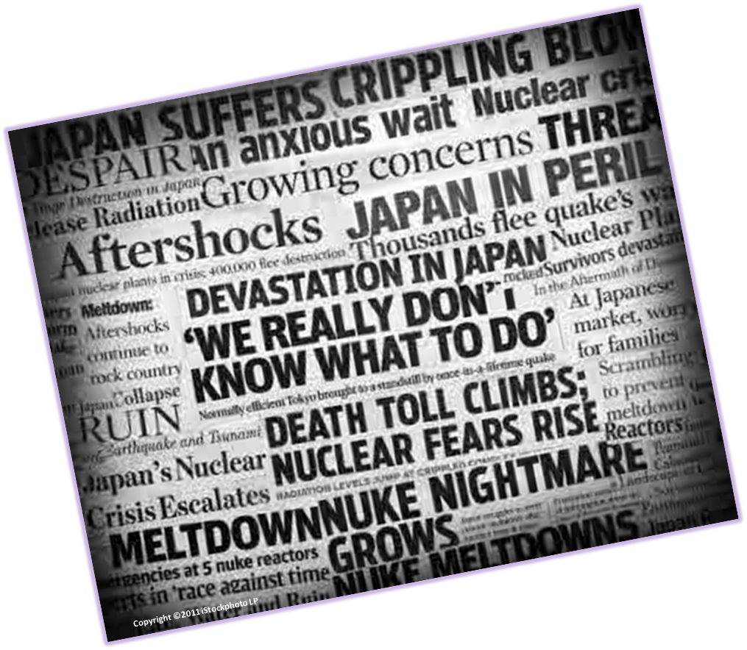
DR-NEP Workflow
SUDDENLY, A DISASTER
Local
EOC
LOCAL /
REMOTE
XOC
INTERDEPENDENCY
CONSULTANTS
INFRASTRUCTURE , UTILITIES, SENSORS
CONSULTANTS
DR-NEP
DEVELOPMENT
CONSORTIUM

Slide 23

DR-NEP Workflow
Network-Enabled Disaster Management
Local
EOC
SIMULATION & EXERCISE ASSESSMENTS
LOCAL /
REMOTE
XOC
DR-NEP KNOWLEDGE DATABASE
INTERDEPENDENCY
CONSULTANTS
INFRASTRUCTURE , UTILITIES, SENSORS
CONSULTANTS
DR-NEP
DEVELOPMENT
CONSORTIUM

Slide 24
DR-NEP Workflow
Network-Enabled Disaster Management
Local
EOC
SIMULATION & EXERCISE ASSESSMENTS
LOCAL /
REMOTE
XOC
SHARED
PAST
EXPERIENCES
DR-NEP KNOWLEDGE DATABASE
INTERDEPENDENCY
CONSULTANTS
INFRASTRUCTURE , UTILITIES, SENSORS
CONSULTANTS
DR-NEP
DEVELOPMENT
CONSORTIUM

Slide 25
DR-NEP Workflow
Network-Enabled Disaster Management
Local
EOC
SIMULATION & EXERCISE ASSESSMENTS
LOCAL /
REMOTE
XOC
SHARED
PAST
EXPERIENCES
INTERDEPENDENCIES & DECISION-MAKING
SIMULATIONS
DR-NEP KNOWLEDGE DATABASE
INTERDEPENDENCY
CONSULTANTS
DISTRIBUTED
SUBJECT MATTER EXPERT
SUPPORT
INFRASTRUCTURE , UTILITIES, SENSORS
CONSULTANTS
DR-NEP
DEVELOPMENT
CONSORTIUM

Slide 26
DR-NEP Workflow
Network-Enabled Disaster Management
Local
EOC
SIMULATION & EXERCISE ASSESSMENTS
DECISION MAKING & COORDINATION
LOCAL /
REMOTE
XOC
SHARED
PAST
EXPERIENCES
INTERDEPENDENCIES & DECISION-MAKING
SIMULATIONS
DR-NEP KNOWLEDGE DATABASE
INTERDEPENDENCY
CONSULTANTS
DISTRIBUTED
SUBJECT MATTER EXPERT
SUPPORT
INFRASTRUCTURE , UTILITIES, SENSORS
CONSULTANTS
DR-NEP
DEVELOPMENT
CONSORTIUM

Slide 27
DR-NEP Workflow
Network-Enabled Disaster Management
Local
EOC
SIMULATION & EXERCISE ASSESSMENTS
DECISION MAKING & COORDINATION
LOCAL /
REMOTE
XOC
SHARED
PAST
EXPERIENCES
INTERDEPENDENCIES & DECISION-MAKING
SIMULATIONS
DR-NEP KNOWLEDGE DATABASE
INTERDEPENDENCY
CONSULTANTS
DR-NEP shared knowledge and best practices available for Canadians
DISTRIBUTED
SUBJECT MATTER EXPERT
SUPPORT
INFRASTRUCTURE , UTILITIES, SENSORS
CONSULTANTS
DR-NEP
DEVELOPMENT
CONSORTIUM

Slide 28
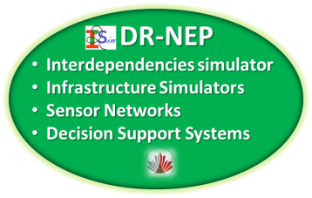
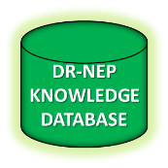
Network-Enabled Disaster Management
Best Practices.
Powerful Simulation Tools.
Knowledge Network.
Disaster Response Network-Enabled Platform DR-NEP

Slide 29
Disaster Response Network-Enabled Platform - DR-NEP
The University of British Columbia
Dr. José R. Martí
Department of Electrical & Computer Engineering
Phone: 604-822-2364
Fax: 604-822-5949
E-mail: jrms@ece.ubc.ca
The University of Western Ontario
Dr. Ernest Yanful
Department of Civil &
Environmental Engineering
Phone: 519-661-4069
Fax: 519-661-3779
E-mail: eyanful@eng.uwo.ca
The University of New Brunswick
Dr. Mihaela Ulieru
Faculty of Computer Science
Phone: 506-458-7277
Fax: 506-453-3566
E-mail: ulieru@unb.ca

